Slide 1






PERSONAL PORTFOLIO
BY . VARSHINI A

Slide 2
INTRODUCING
The personal portfolio project is designed to showcase my skills, experience, and projects. The portfolio includes sections for my profile, contact information, education, skills and coursework, and project details. The goal is to provide a comprehensive overview of my professional background in a visually appealing format.

Slide 3
HTML STRUCTURE
THE HTML FILE IS ORGANIZED INTO KEY SECTIONS:
  HEADER: DISPLAYS PROFILE PICTURE, NAME, AND TITLE.
  Contact Information: Includes date of birth, phone number, email, LinkedIn profile, personal website, and address.
  Education: Lists educational background and degrees.
  Skills and Coursework: Highlights key skills and completed coursework.
  Projects: Describes projects and their relevance.
  Footer: Contains copyright information.

Slide 4
CSS STYLING
THE CSS FILE DEFINES THE STYLING FOR THE PORTFOLIO
  FLEXBOX LAYOUT: USED FOR ALIGNING AND SPACING ELEMENTS.
  Profile Picture Styling: Ensures the profile picture is displayed correctly with a round shape.
  Typography: Consistent font styles for readability.
  Responsive Design: Adjusts layout based on screen size for better accessibility.

Slide 5
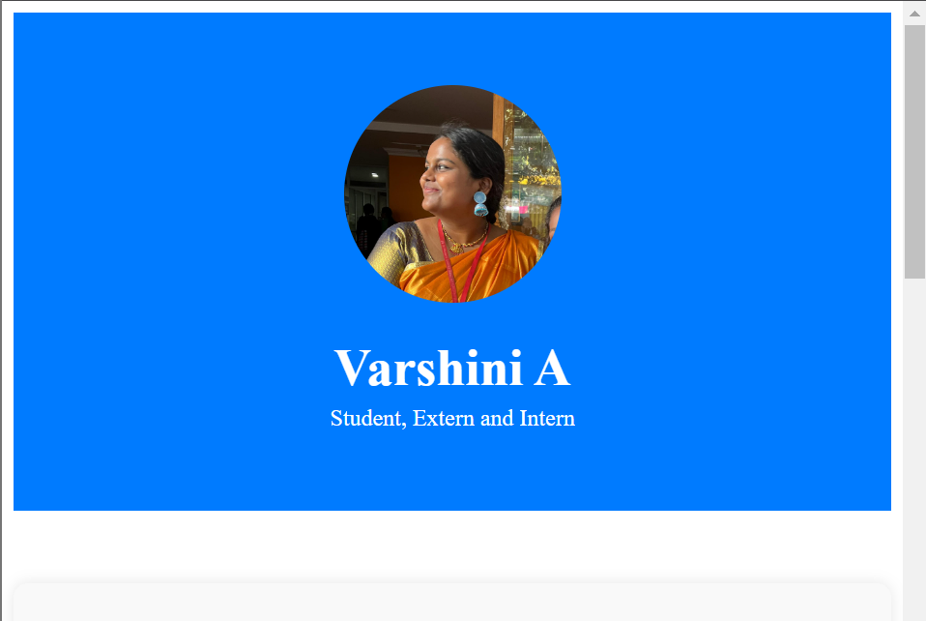

Slide 6
PROFILE SECTION
THE PROFILE SECTION INCLUDES:
  PROFILE PICTURE: CENTER-ALIGNED WITH A CIRCULAR SHAPE.
  Name and Title: Displayed prominently below the profile picture.
  Container: Ensures content is well-organized and centered.

Slide 7
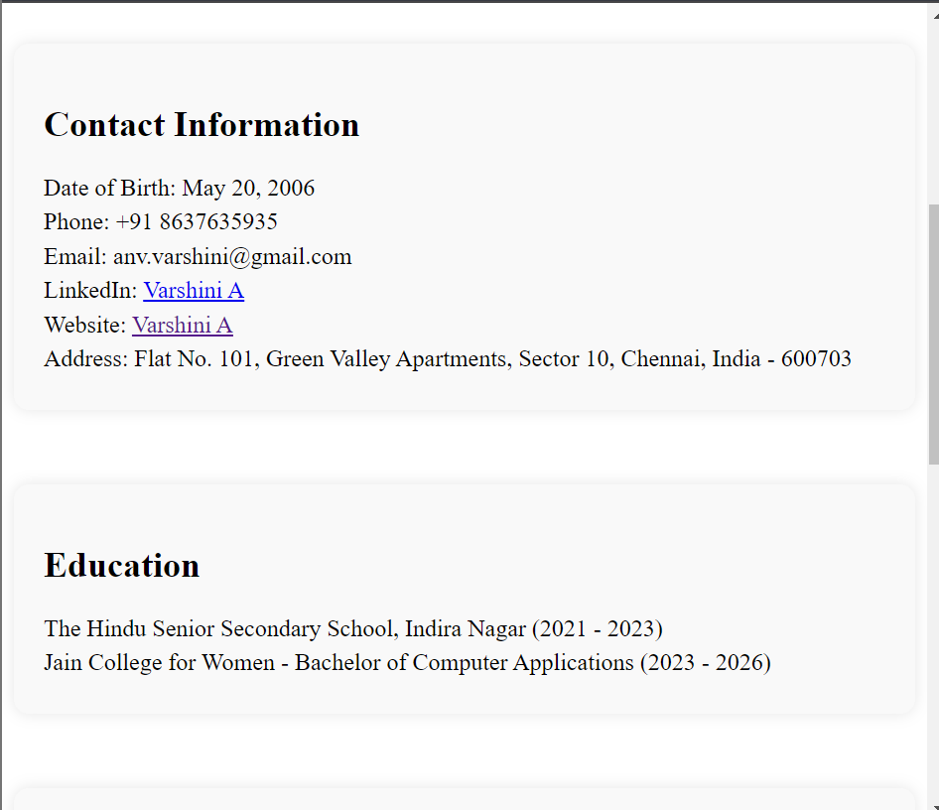

Slide 8
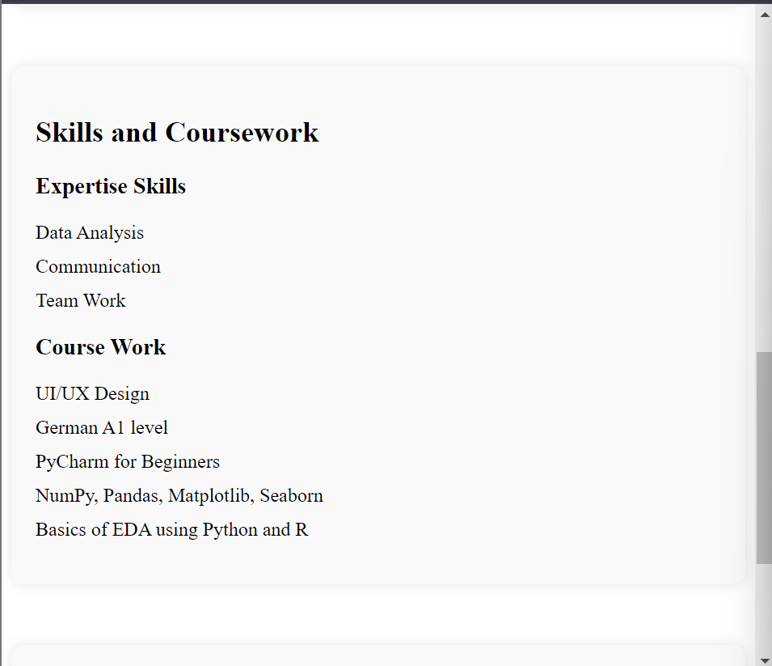

Slide 9
CONTACT INFORMATION
THE CONTACT INFORMATION SECTION PROVIDES:
  PERSONAL DETAILS: DATE OF BIRTH, PHONE NUMBER, EMAIL, LINKEDIN, PERSONAL WEBSITE, AND ADDRESS.
  Links: Clickable links for LinkedIn profile and personal website.
  Formatting: Ensures information is easy to read and well-organized.

Slide 10
EDUCATION AND SKILLS
THE EDUCATION AND SKILLS SECTION HIGLIGHTS:
  EDUCATIONAL BACKGROUND: LISTS SCHOOLS, DEGREES, AND YEARS ATTENDED.
  SKILLS AND COURSEWORK: PROVIDES A LIST OF KEY SKILLS AND RELEVANT COURSEWORK.
  LIST FORMATTING: USES BULLET POINTS FOR CLARITY AND READABILITY.

Slide 11
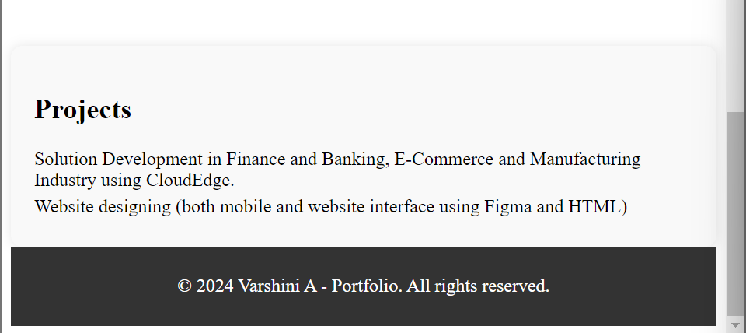

Slide 12
PROJECTS SECTION
THE PROJECT SECTION DESCRIBES
  PROJECT DETAILS: LISTS PROJECTS WITH BRIEF DESCRIPTIONS.
  RELEVANCE: EXPLAINS THE IMPORTANCE OF EACH PROJECT.
  FORMATTING: ENSURES EACH PROJECT IS CLEARLY SEPARATED AND EASY TO READ.

Slide 13
CONCLUSION
IN CONCLUSION, THE PERSONAL PORTFOLIO EFFECTIVELY PRESENTS MY PROFESSIONAL BACKGROUND AND SKILLS. THE USE OF HTML AND CSS ENSURES A VISUALLY APPEALING AND USER-FRIENDLY LAYOUT, PROVIDING A COMPREHENSIVE OVERVIEW OF MY EXPERIENCE AND CAPABILITIES.
PS: The contact info in the project is not my own, its just a sample.

